Slide 1
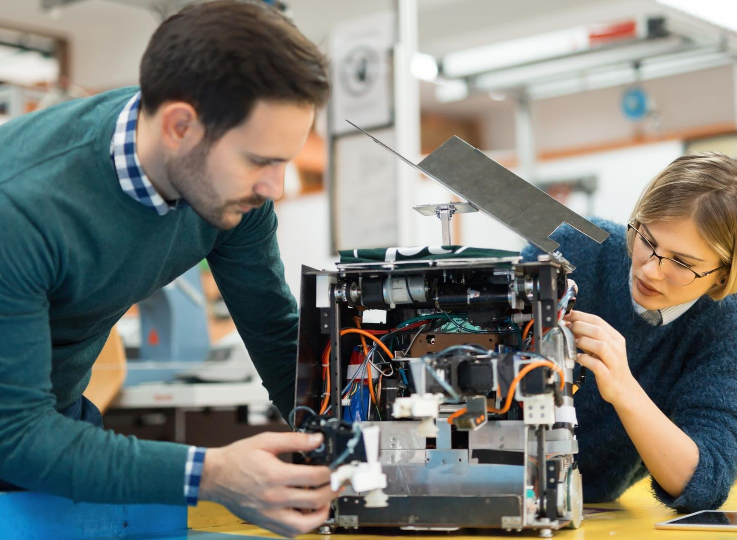
Programa tu Paladar: EY Recipe Development Challenge

Slide 2
Develop a comprehensive web application for a recipe sharing service that allows users to manage recipes, interact with user-generated content, and offer an attractive and accessible user experience in both the front-end and back-end.

Slide 3
Back-End
Project Setup:
Creation of a back-end project.
Creation of a suitable database.
API for Recipes:
Implementation of CRUD functions for recipes.
Data pagination and filtering.
File upload and download for image files.
Security and Performance:
Rate limiting to prevent abuse.
Authentication and user session management.
Implementation of caching strategies.
Robustness and Maintainability:
Error handling and activity logging.
API versioning for future updates.
Advanced Features:
Internationalization (i18n) to support multiple languages.
Real-time data endpoint for live updates.
Documentation and Maintainability:
Clear and complete documentation of the API.
Development practices that facilitate the maintainability and scalability of the project.

Slide 4
Front-End
Project Setup:
Creation of an attractive and functional design that is responsive and accessible.
API Connection:
Integration of the front-end with the back-end to display and manage recipes.
Interactivity and User Experience (UX):
Responsive and accessible design that adapts to different devices and screen sizes.
Implementation of forms for adding, editing, and deleting recipes.
Features for rating and commenting on recipes.
Optimization and Security:
Techniques to improve the performance of the application.
Security measures to protect the application on the client side.
Documentation and Maintainability:
Clear and complete documentation of the code.
Development practices that facilitate the maintainability and scalability of the project.

Slide 5
Unified Database Schema
Consistency Across Projects: To ensure consistency and comparability across all projects in the "Programa tu Paladar" challenge, we will be providing a standardized database schema that all participants must use.
Database Schema Details:
The provided schema will outline the structure of the database, including tables, columns, data types, and relationships.
The database schema will be made available in both SQL Server and PostgreSQL formats within a GitHub repository named "programa-tu-paladar-database".
Participants can clone or download the schema directly from the repository to ensure they are using the latest version.
If you have any questions about the database schema or need assistance with implementation, please reach out the team

Slide 6
Participation Rules
Choose Your Own Path: You have the freedom to choose how you want to participate. Whether you prefer to work independently or collaborate as a team.
Technologies Tailored for You: We also give you the liberty to select the technologies and programming languages that you are most passionate about or wish to delve into.
Unique Project for Each Team/Individual: A dedicated GitHub project will be created for each team or individual participant, named using the format "programa-tu-paladar-<teamname>".
Standardized Folder Structure:
code/: This folder will contain all the source code for the project, including front-end and back-end code, organized as necessary for the chosen technologies and languages.
docs/: This directory is designated for all documentation related to the project. It should include technical documentation, API references, design documents, and any other relevant written materials that explain the project's functionality and architecture.
assets/: A place for any additional resources such as images, design files, or other media that support the project.

Slide 7
Participation Rules
Collaboration and Workflow:
Teams and individual participants are encouraged to use the GitHub project to manage their workflow, track issues, and collaborate effectively.
The use of pull requests, code reviews, and project boards within GitHub will facilitate a transparent and organized development process.
Documentation and Contribution Guidelines:
Each project should include a README file in the root directory that provides an overview of the project, setup instructions, and how to run the code.

Slide 8
Participation Rules
How to Participate:
If you choose to form a team, ensure all members are in agreement and committed to the project.
Create a name for the team or the project of maximum 3 words
Select the technologies and languages you will use.
Send your decision via email to gustavo.arrieta@cr.ey.com, juan.ruyan@gt.ey.com or daniel.herrera2@cr.ey.com with
Name of the team/project
List of all GitHub accounts that need access to the repository.
List of technologies that will be used.
Deadline: June 10th

Slide 9


